Slide 1
Agentic Automation (with Managerial Accounting)
Acctg & Fin | BUS AN 500 | Class 05
Spring Qtr | 2026

Slide 2

What will we do today?
Review
Accounting & finance function
Intelligent automation demo
Managerial accounting overview
Budgeting and control
Variance Analysis Lab
Understanding the manual process
RPA Steps v. agents
Humans: Policy decision making
Time permitting, final project in-class time

Slide 3
Accounting & Finance Function
External Users
Owners and other stakeholders
Banks
Internal Users
Users within a Company
Board of Directors
Managers
Employees
Investors
Shareholders
External Auditor
Creditors
Tax Agencies
Media
Students
Governments

Slide 4
An information and decisions approach
 | Financial Accounting | Managerial Accounting
Users and decision makers | External: Investors, creditors, and other external users | Internal: Managers, employees
Purpose of the information | Help external users make investment, credit and other decisions | Help managers make planning and control decisions
Flexibility of reporting | Structure, follows GAAP requirements plus voluntary disclosures | Flexible; can be structured as to best inform managers
Timeliness of information | Public after period end after an audit | Available on demand
Time dimension | Historical information with some projections | Future information, including projections and forecasts backed with historical data
Focus of information | Aggregate entity-level with some segmented data | Detailed around projects, processes and divisions
Nature of information | Monetary with voluntary non-monetary | Monetary and non-monetary including KPIs

Slide 5
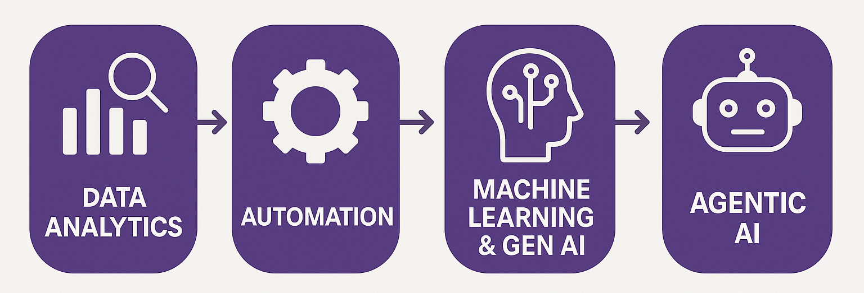
Process Diagram
How can we use data analytics and automation tools to improve decisions?

Slide 6
Financial reporting example
Task:
From an external user’s perspective, understand Apple, Inc’s revenue growth and drivers of that growth.
Why:
We want to consider an investment in APPL.

Slide 7
Financial reporting e.g., two manual steps
Task:
From an external user’s perspective, understand Apple, Inc’s revenue growth and drivers of that growth.
Manual approach:
Calculate revenue growth / trends by collecting revenue data for APPL.
Collect information about how APPL talks about it’s revenue (e.g., in the Management Discussion and Analysis section of the 10-K)

Slide 8
Financial reporting e.g., manual step 1
Task:
From an external user’s perspective, understand Apple, Inc’s revenue growth and drivers of that growth.
Manual approach:
Calculate revenue growth / trends by collecting revenue data for APPL.
Maybe use the 10-K? Collect from the income statement?
Use a third party, like Yahoo! Finance?
Enter into spreadsheet and calculate year-over-year growth.

Slide 9
Financial reporting e.g., manual step 2
Task:
From an external user’s perspective, understand Apple, Inc’s revenue growth and drivers of that growth.
Manual approach:
Collect information about how APPL talks about it’s revenue (e.g., in the Management Discussion and Analysis section of the 10-K)
Get the 10-K, find the MD&A in the index and go to that section.
Read and make notes from the discussion.
Make a judgement about the discussion that supports revenue growth.

Slide 10
What can RPA do here?
RPA approach:
Calculate revenue growth / trends by collecting revenue data for APPL.
Connect to SEC’s API and download AAPL’s disclosed Revenues, calculate the year-over-year change, report back as a Table.
Collect information about how APPL talks about it’s revenue (e.g., in the Management Discussion and Analysis section of the 10-K)
Download the 10-K filing, use a rule to identify the MD&A section, return it as text (removing html tags).
Read and make notes from the discussion.
Make a judgement about the discussion that supports revenue growth.

Slide 11
What can an Intelligent RPA workflow add?
RPA passes:
Revenue growth table and MD&A section to the LLM based agent.
LLM agent can then:
Summarize the revenue trends and find textual associations linked to revenue growth (like us reading and making notes).
Provide insight to support a judgement about the discussion that supports revenue growth by providing a requested output.

Slide 12
Intelligent Automation Demo
Financial Reporting: AAPL example

Slide 13
What will we do today?
Review
Accounting & finance function
Intelligent automation demo
Managerial accounting overview
Budgeting and control
Variance Analysis Lab
Understanding the manual process
RPA Steps v. agents
Humans: Policy decision making
Time permitting, final project in-class time

Slide 14
What is managerial accounting
An internal (to the firm) user’s perspective on using accounting information to support:
Planning, directing and motivating employees, (cost) controlling, and evaluation responsibilities of managers.

Slide 15
Why is it important?
Managerial accounting tools:
Transforms raw data into actionable decisions
Identifies where managerial attention is needed
Distinguishes signal from noise in performance (and performance evaluation)
Enables timely intervention (not just post-hoc analysis)
Serves as a trigger for action (not just measurement)

Slide 16
Managerial Decisions
Managerial decisions that can be supported by managerial accounting tools include examples like:
Should we rent or buy a new location?
Can be very important for retail companies (e.g., Starbucks)
Should we onboard or outsource an activity?
Can be very important for service firms (e.g., CPAs and banks)
Should we build an internal AI data warehouse or rely on OpenAI / Claude subscriptions?
Can be very important for software companies (e.g., SAAS)

Slide 17
What is common between these decisions?
In each case, accounting information helps identify when a decision is required what trade-offs matter:
Should we rent or buy a new location?
Trade-off between fixed commitments and flexibility
Should we onboard or outsource an activity?
Trade-off between control, cost, and scalability
Should we build an internal AI data warehouse or rely on OpenAI / Claude subscriptions?
Trade-off between upfront investment and usage-based costs

Slide 18
The commonality:
These are all trade-off decisions about trade-offs when managers face uncertainty using (historical and projected) cost information.
These decisions are often triggered by:
cost changes
performance gaps
or unexpected variances

Slide 19
What will we do today?
Review
Accounting & finance function
Intelligent automation demo
Managerial accounting overview
Budgeting and control
Variance Analysis Lab
Understanding the manual process
RPA Steps v. agents
Humans: Policy decision making
Time permitting, final project in-class time

Slide 20
Variance Analysis Lab Overview
Using Variance Analysis as a setting, we will think about the following decision process:
Variance analysis → “Where did expectations break?”
Automation (RPA) → “We can detect this automatically”
Agent (LLM) → “Here’s what matters and what to do”
Human → “Should we act, and how?”

Slide 21
Our lab question
Our firm is (almost) 10% over budget. Is this a problem, or just noise? What should we do?

Slide 22
What will we do today?
Review
Accounting & finance function
Intelligent automation demo
Managerial accounting overview
Budgeting and control
Variance Analysis Lab
Understanding the manual process
RPA Steps v. agents
Humans: Policy decision making
Time permitting, final project in-class time

Slide 23
The manual process, create report
To manually (or automatically) create a report we need:
Budget data (usually aggregated to a unit / project level)
Actual spending data (usually not aggregated)
Steps:
Obtain both datasets
Aggregate actuals to same units as budgets
Join the budget and actual data

Slide 24
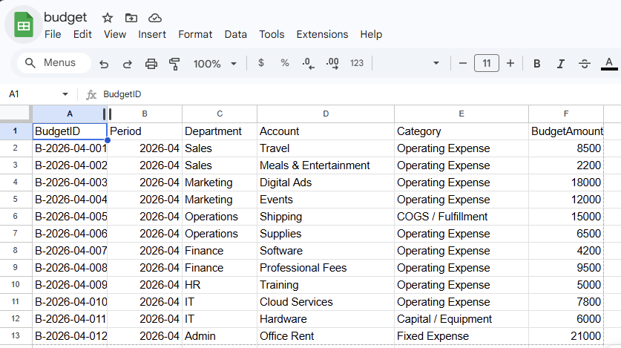

Slide 25
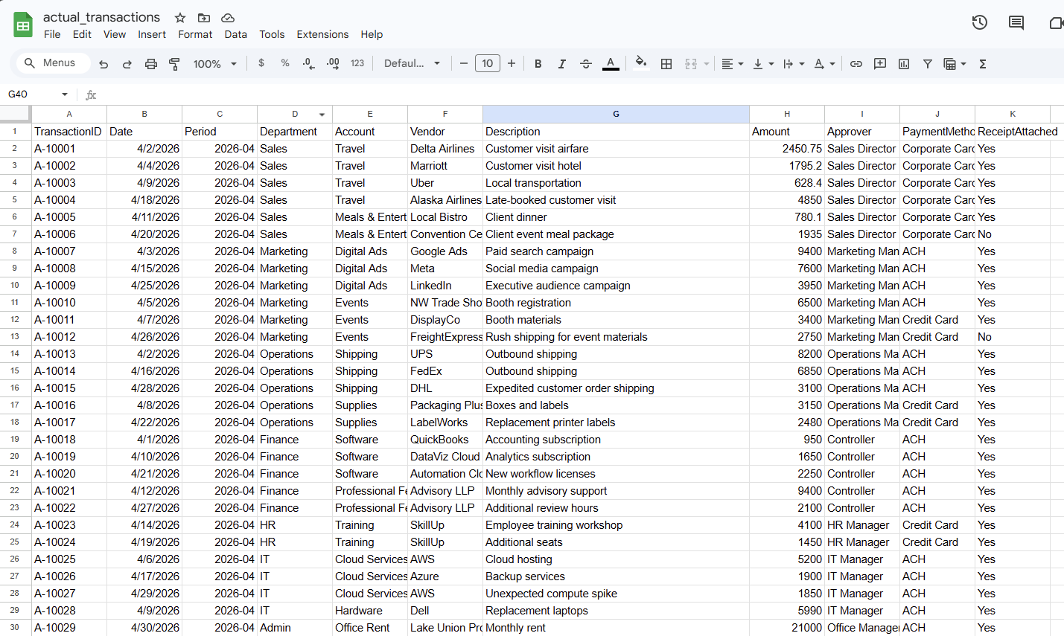

Slide 26
The manual process, analyze report
A manager receives a variance report and:
Reviews overall budget vs actual
Identifies large or unusual variances
Drills into departments / accounts / units / projects
Investigates potential causes
Determines whether the variance is:
signal (requires action)
noise (can be ignored)
Decides whether to act
Communicates findings / recommendations

Slide 27
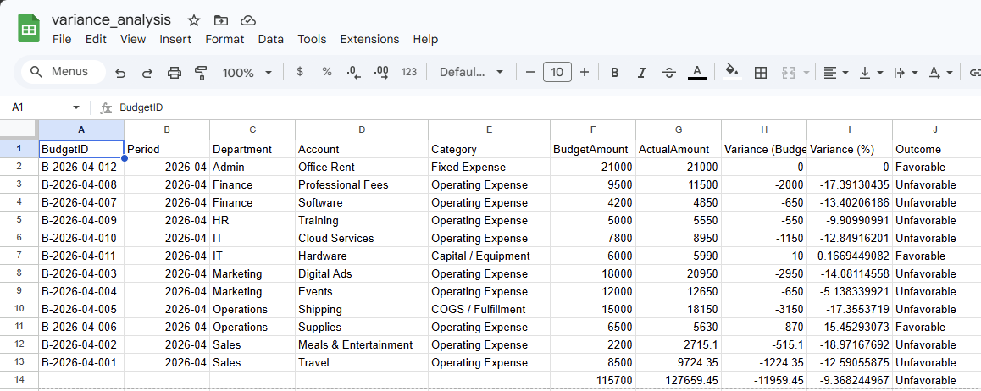

Slide 28
What will we do today?
Review
Accounting & finance function
Intelligent automation demo
Managerial accounting overview
Budgeting and control
Variance Analysis Lab
Understanding the manual process
RPA Steps v. agents
Humans: Policy decision making
Time permitting, final project in-class time

Slide 29
Where does the manual process become difficult?
Large volume of data / large numbers of (unfavorable) variances
Time constraints
Inconsistent judgment / Limited visibility into causes
If it is hard to prioritize what matters

Slide 30
RPA helpers versus Agent helpers
Step | RPA (Automation) | Agent (Interpretation)
Data ingestion | Reads budget and actuals | —
Aggregation | Computes totals and variances | —
Detection | Flags differences | —
Interpretation | — | Explains what happened
Prioritization | — | Identifies what matters most
Recommendation | — | Suggests actions
Decision | — | Supports human judgment

Slide 31
RPA helpers versus agent helpers
RPA answers: “What happened?”
Agents answer: “What does it mean and what could we do?”
Humans decide whether a change is needed

Slide 32
Lab time
See and Fill in the rest of the template for today’s class:
Use an LLM to get insight from the variance and actuals data.
Add the policy document as a follow-up and ask for recommendations on rewriting the policy.
Reflection activity.

Slide 33
Team check in
Decide on your focus area as a team, internal (manager) or external (investor) decision maker?
Choose a potential question you’d like to answer within a broad area – (see slides in the appendix) or pick a broad area and I’ll supply a question.

Slide 34
Thank you

Slide 35
Appendix
Reminder of Final Project Requirements

Slide 36
Intelligent Automation Team Challenge
A team project that focuses on an enterprise level automation robot aimed at solving an Accounting & Finance problem.
The bot can be demonstrated in a proof-of-concept state.
Has a Generative Artificial Intelligence (LLM) and/or Agentic AI / AI Agents component.

Slide 37
Requirements
Software deliverable: A prototype (or example) of a solution to the problem.
Presentation deliverable: Discussion of the problem being solved, how the agent benefits the task or workflow, and an evaluation of the usefulness of the Agent or LLM example.

Slide 38
Accounting & Finance Focus Areas
We will focus on the following core areas:
Financial Performance & Forecasting
Budgeting & Financial Planning and Analysis (FPA)
Project Evaluation & Risk
Teams have the option to choose from these areas (or some other options).

Slide 39
Structuring the problem
I will provide each team with a problem from within the Accounting & Finance Function* for this problem, you will be asked to present an AI- agent solution to the use-case focusing on:
What does an intelligent agent need to know, compute, and determine/reason?
* If your team is interested in solving a different problem from the pool of potential ones I offer let me know

Slide 40
Structuring the project
The project will have each team focus on
What are the appropriate inputs/data?
What is the model or logic used to solve the problem?
What decisions and explanations do I want the agent’s help on?

Slide 41
Financial Analysis & Forecasting
Data: transactions, financial statements, earnings reports
Logic: Trend analysis & ratio analysis
Agent Role: Explain performance & generate insights, predict outcomes & explain key assumptions
Users/audience: Internal (managers) and external (investors) to the firm

Slide 42
Budgeting and & Financial Planning and Analysis
Data: Transactions / budgets versus actuals reports (internal).
Logic / tools: variance analysis, relevant costs, cost allocation.
Agent roles: Diagnose what went wrong (missing a budget target), aid in filtering decision-relevant information (relevant v irrelevant costs).
Users/audience: Internal management decisions.

Slide 43
Project Evaluation & Risk
Data: investment targets, risk/return estimates and cost of capital, projected future cash-flows.
Logic tools: Time value of money, valuation, capital asset pricing models.
Agent roles: Rank & Recommend Investment decisions based on a set of targets, simulate uncertainty and risk analysis and/or evaluate investment trade-offs over time.
Users/audience: Mangers and investors.

Slide 44
Some other potential focus areas
Fraud Detection
Portfolio Management
Environmental, Social and Governance reporting
Personal Finance
Wealth Planning
Tax Optimization
Compliance
Cybersecurity
Blockchain

Slide 45
Structuring the data
Simulate data internal company inputs for this task or use real company disclosures and/or stock prices.

Slide 46
Proof-of-concept / prototype
Multiple possible approaches:
Goal: Proof of agent concept (UiPath, Python, LLM) without automation **do this part first.
Goal: Proof of concept process map in business process mapping notation (BPMN) **do this second.
Goal: Working automation workflow prototype with agents using business process mapping notation (UiPath, Python). **optional; do this third.

Slide 47
Presentation Preparation
Each team will present for up to 15 minutes plus up to a 5 minute Q&A.
What is the problem, why is it important
What your solution achieves
Mechanics of the solution (data inputs, process, outputs)
Conclusion and Q&A
Non-presenting class members are expected to ask questions.

